Slide 1
Microcontroller 8051-Architecture and Salient features.

Slide 2
Contents:
Introduction
8051 Architecture
8051 Pin Configuration
8051 Input Output ports
8051 Interrupts
Salient Features
Conclusion

Slide 3
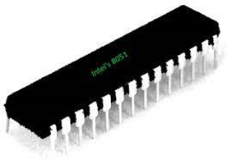
Introduction:
A microcontroller is a small computer on a single metal-oxide-semiconductor (MOS) integrated circuit (IC) chip. A microcontroller contains one or more CPUs (processor cores) along with memory and programmable input/output peripherals.

Slide 4
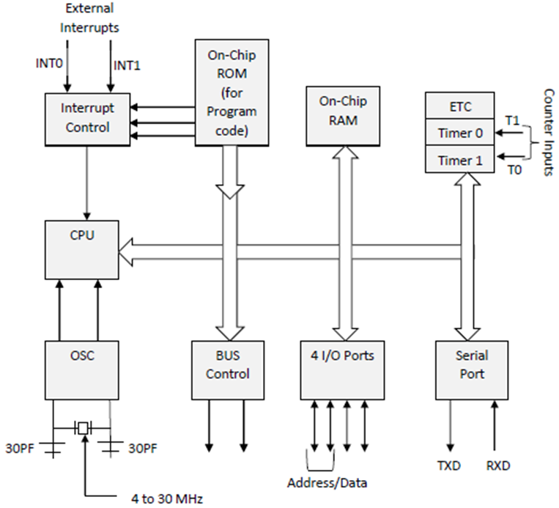
Architecture:
The system bus connects all the support devices to the CPU. The system bus consists of an 8-bit data bus, a 16-bit address bus and bus control signals. All other devices like program memory, ports, data memory, serial interface, interrupt control, timers, and the CPU are all interfaced together through the system bus.

Slide 5
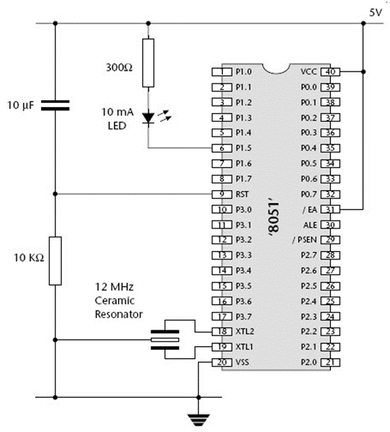
Pin Configuration:
The 8051 microcontrollers consist of 40 pins which are dedicated to several functions such as I/O, address, RD, WR, data and interrupts. A total of 32 pins are set away into four Ports such as P0, P1, P2 and P3. Where, each port contains 8 pins.

Slide 6
Input Output Ports:
8051 microcontrollers have 4 I/O ports each of 8-bit, which can be configured as input or output. Hence, total 32 input/output pins allow the microcontroller to be connected with the peripheral devices.
If any pin of this port is configured as an input, then it acts as if it “floats”, i.e. the input has unlimited input resistance and in-determined potential.
When the pin is configured as an output, then it acts as an “open drain”. By applying logic 0 to a port bit, the appropriate pin will be connected to ground (0V), and applying logic 1, the external output will keep on “floating”.

Slide 7
IE(Interrupt Enable)Register:
EA | IE.7 | It disables all interrupts. When EA = 0 no interrupt will be acknowledged and EA = 1 enables the interrupt individually.
- | IE.6 | Reserved for future use.
- | IE.5 | Reserved for future use.
ES | IE.4 | Enables/disables serial port interrupt.
ET1 | IE.3 | Enables/disables timer1 overflow interrupt.
EX1 | IE.2 | Enables/disables external interrupt1.
ET0 | IE.1 | Enables/disables timer0 overflow interrupt.
EX0 | IE.0 | Enables/disables external interrupt0.

Slide 8
IE(Interrupt Priority)Register:
- | IP.6 | Reserved for future use.
- | IP.5 | Reserved for future use.
PS | IP.4 | It defines the serial port interrupt priority level.
PT1 | IP.3 | It defines the timer interrupt of 1 priority.
PX1 | IP.2 | It defines the external interrupt priority level.
PT0 | IP.1 | It defines the timer0 interrupt priority level.
PX0 | IP.0 | It defines the external interrupt of 0 priority level.

Slide 9
Salient Features:
On-chip RAM
On-chip ROM
Timers and Counters
Serial Port
Input and Output Ports
Oscillator
Interrupts
Arithmetic Logic Unit
Accumulator
B register
Program Counter
Flags Bits and PSW register

Slide 10
Conclusion:
The 8051-microcontroller architecture provides many functions (central processing unit (CPU), random-access memory (RAM), read-only memory (ROM), input/output (I/O) ports, serial port, interrupt control, timers) in one package. The 8051 microcontrollers have made a significant improvement in digital systems with low time required for performing operation. They’re highly economical due to their higher integration. They can easily interface with additional RAM, ROM and I/O ports.

Slide 11
THANK YOU!

